Slide 1


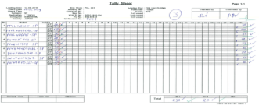

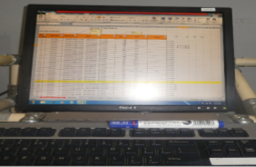

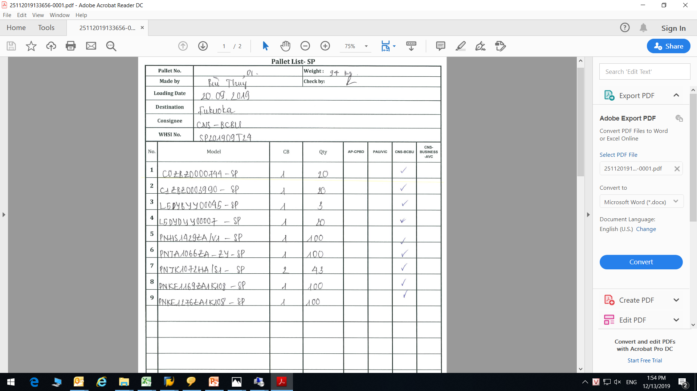
APPLY ELECTRONIC TALLY SHEET FOR SERVICE PART SHIPMENT
TIME
8/10
Section: PSCS
PIC: Mrs.Thu
Applied: Oct 2019
Investment: 0$
◆Before
◆ After
Manual writing
Tally sheet
Barcode
Auto link data on software
Pallet list
Electronic Pallet List
Electronic tally sheet
About 36 service part shipment/ month (180 pallets)
Time spending to count q.ty, writing the model name on
tally sheet & pallet list:
Time spending: 50 minutes/shipment
~ 1800 minutes/36 shipment (30 hours)/month
~ 360 hours/year.
.
Using barcode checker to scan q.ty and model of each shipment. Reduce 50% time when prepare Service part for shipment.
Take time: 25 minutes/shipment
~ 900 minutes/36 shipments/month
~ 15 hours/month ~ 180hours/Year
Save time: 360 hours – 180 hours = 180 hours/year
Save cost: 245 USD/Year

